Slide 1
Learning and Training Department
A

Slide 2
Concerns with current training department
I have taken one session in the recent past and there is no feedback on it
I found lot of guys coming to me asking for presentation that I have made . They are not sure where these presentations are going and who is using them
Lot of employees ask me for presentations that I have made in the past and I am not sure where they are ?
Can any department tell how many presentations I have made , quality of presentations ?
Do you recognize efforts put down by a person to make a presentation so that he will repeat the act .
I want to do PMP certification and if I approach learning department can they point me to a mentor who will help me in fulfilling my goal
As of today quality of sessions is extremely poor (especially Friday sessions) because of which trainers and listeners both of them lost interest in training department
I came across an excellent article how can I share it with whole prokarma ?
I came across an excellent online video content . How can I share with prokarma.
I never approached training department hoping they will empower me to new levels .

Slide 3
Four simple steps to fix above problems
Create wiki space
Set high expectations and sell your expectations to existing and new employees .
Create confidence in employees about learning & training department
Recognize and award people to create good trainers and mentors
Note : By the time I complete this presentation you will understand clearly how to address all these problems .

Slide 4
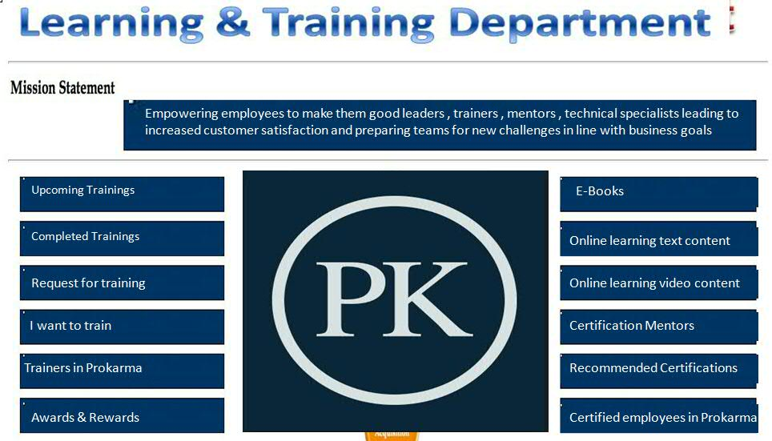
Wiki Space

Slide 5
Mission
I believe we require four categories of employees that will make us more successful - Great leaders , Great trainers , Great mentors , Technical & Project management experts
Our mission statement should help our people in understanding what we are doing
I have few thoughts on creating a mission statement and this is what came to my mind – “ Empowering employees to make them good Leaders , Trainers , Mentors , Technical & Project management experts leading to increased customer satisfaction and preparing teams for new challenges in line with business goals ”
Better thoughts ?

Slide 6
Upcoming Trainings
Opening note talking about importance of registering to attend training (Today many are not registering)
Should contain table data with all following columns –
S.No
Presentation Topic
Presenter name
Target Audience
Timing Details
Registration link (Pointing to PKonnect )
Number of registrations (Should get updated periodically)
Status (Registration opened / Registration closed)

Slide 7
Focus on quality of work and non functional requirements
Maintain good test coverage for all our DU’s
Maintain good sonar report
Good code review comments (We are adding task for every new deployment unit . So no question of skipping it)
Ensure jenkins jobs are stable

Slide 8
Focus on quality of work and non functional requirements
Maintain good test coverage for all our DU’s
Maintain good sonar report
Good code review comments (We are adding task for every new deployment unit . So no question of skipping it)
Ensure jenkins jobs are stable

Slide 9
Focus on quality of work and non functional requirements
Maintain good test coverage for all our DU’s
Maintain good sonar report
Good code review comments (We are adding task for every new deployment unit . So no question of skipping it)
Ensure jenkins jobs are stable

Slide 10
Focus on quality of work and non functional requirements
Maintain good test coverage for all our DU’s
Maintain good sonar report
Good code review comments (We are adding task for every new deployment unit . So no question of skipping it)
Ensure jenkins jobs are stable

Slide 11
Focus on quality of work and non functional requirements
Maintain good test coverage for all our DU’s
Maintain good sonar report
Good code review comments (We are adding task for every new deployment unit . So no question of skipping it)
Ensure jenkins jobs are stable

Slide 12
Focus on quality of work and non functional requirements
Maintain good test coverage for all our DU’s
Maintain good sonar report
Good code review comments (We are adding task for every new deployment unit . So no question of skipping it)
Ensure jenkins jobs are stable

Slide 13
Focus on quality of work and non functional requirements
Maintain good test coverage for all our DU’s
Maintain good sonar report
Good code review comments (We are adding task for every new deployment unit . So no question of skipping it)
Ensure jenkins jobs are stable

Slide 14
Focus on quality of work and non functional requirements
Maintain good test coverage for all our DU’s
Maintain good sonar report
Good code review comments (We are adding task for every new deployment unit . So no question of skipping it)
Ensure jenkins jobs are stable

Slide 15
Focus on quality of work and non functional requirements
Maintain good test coverage for all our DU’s
Maintain good sonar report
Good code review comments (We are adding task for every new deployment unit . So no question of skipping it)
Ensure jenkins jobs are stable

Slide 16
Focus on quality of work and non functional requirements
Maintain good test coverage for all our DU’s
Maintain good sonar report
Good code review comments (We are adding task for every new deployment unit . So no question of skipping it)
Ensure jenkins jobs are stable

Slide 17
Focus on quality of work and non functional requirements
Maintain good test coverage for all our DU’s
Maintain good sonar report
Good code review comments (We are adding task for every new deployment unit . So no question of skipping it)
Ensure jenkins jobs are stable

Slide 18
Focus on quality of work and non functional requirements
Maintain good test coverage for all our DU’s
Maintain good sonar report
Good code review comments (We are adding task for every new deployment unit . So no question of skipping it)
Ensure jenkins jobs are stable

Slide 19
Focus on quality of work and non functional requirements
Maintain good test coverage for all our DU’s
Maintain good sonar report
Good code review comments (We are adding task for every new deployment unit . So no question of skipping it)
Ensure jenkins jobs are stable

Slide 20
Focus on quality of work and non functional requirements
Maintain good test coverage for all our DU’s
Maintain good sonar report
Good code review comments (We are adding task for every new deployment unit . So no question of skipping it)
Ensure jenkins jobs are stable

Slide 21
Focus on quality of work and non functional requirements
Maintain good test coverage for all our DU’s
Maintain good sonar report
Good code review comments (We are adding task for every new deployment unit . So no question of skipping it)
Ensure jenkins jobs are stable

Slide 22
Weekly meetings
Let us add these three questions to our weekly meetings
Is our customer happy this week ?
Did we find any new opportunities to make our customers happy ? We need to listen to our customer carefully to identify new opportunities .
Let us acknowledge and appreciate all our team members who got appreciation mails from customer that week .

